Slide 1


Prizes and Suprises
Adventures in implementation of the Prize Engine

Slide 2

What we are going to do
Rehash the concept of the Prize Engine
See what issues I ran into implementing it
Think about ways to add to the concept

Slide 3
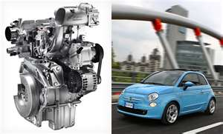
What is the Prize Engine
Having a resource that is only awarded when person meets certain criteria
Prize engine allows AND, Or and If conditions to be evaluated
Prize engine allows logic statements with large set of evaluation options

Slide 4
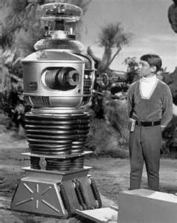
Actual first application- Early Alerts
When a students meets the given grade requirements(low grades set by administrator) they are sent an email
Can be scheduled to execute weekly

Slide 5


Next Application- New Start
When a student does certain tasks they are awarded with an email
After other tasks the user is allowed entrance to other parts of the application
Other task completion markers get students T-Shirts, class and rooms

Slide 6

Next Application-SU
Students are allowed to see scholarships if they meet certain criteria
Currently- AND logic and If Statements
Prize engine will add OR and more complex IF statements

Slide 7

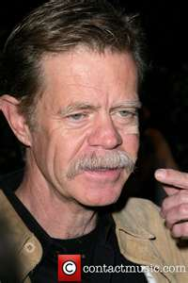
Basic Ideas-Characteristics
People have characteristics
Characteristics have types which allow certain type of operations
Numbers-less than or greater than
Lists-have in list, one in list, etc.

Slide 8

Basic Ideas -Prizes
Prizes have conditions to meet before being awarded
Prizes have 0 or more Conditions
Conditions can be OR, IF or AND lists of logical statement evaluations
Conditions must have 1 or more logic statements

Slide 9

Basic Idea-Logic Statements
Statements are logical evaluations
Which operations are allowed are based on characteristic type

Slide 10
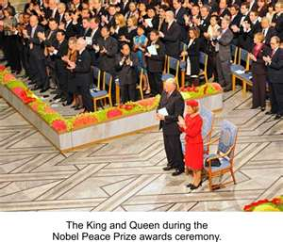
Basic Ideas-Result
If person meets conditions of prize they are awarded the prize
Now let’s see how the prize engine worked in early alerts

Slide 11

Early Alerts Issues
Prize Environment idea
Found out it is too different to have required abilities (Interface)
Conversion from db to logic too slow
Too Bloated

Slide 12
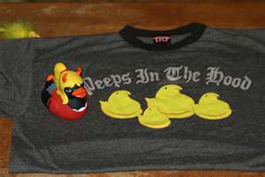
Peeps are in the house
Don’t add Persons, Characteristics, these are givens
Person Characteristics-some I add and need to mesh with existing data
Need to log data at time and not calculate again

Slide 13

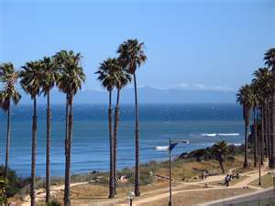
Fixes-Views
Person is a view
Need to link prize to class and only get persons for class
PersonCharacteristics is a view with a union on my data
Insert in items to allow person override
Characteristics are predefined grades

Slide 14

Fixes- Slowness
Created Views so that SubSonic will create objects for me
No need to convert into typed objects
Used partial classes to add functionality
Subsonic objects implement interface
Subsonic implements property changed events

Slide 15
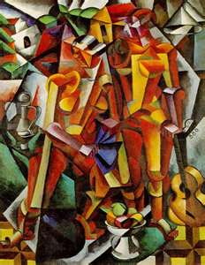
Fixes-What is really needed
Using tt files
Instead of abstract classes
Minimize the number of necessary items
Example-Events

Slide 16

Ways to handle events
EventHandler<object>
Cast object in eventhandler
CustomDelegate<Interface>
Limits to items which are in interface
EventHandler<strong object>
Can’t be more general solution
Pre and Post Functions
PreCacluate
PostCalculate

Slide 17

Fixes-logging values
When inserting new prize
Insert valid users into appcharacteristics
Insert into prize structure
Add personprize with null
Add condition with null
Add logic statement with null
Pull back values and calculate
Person Logic statements
Person Conditions
Person Prizes

Slide 18
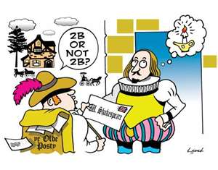
TO enum or not enum
Good-Enumeration are a great way to limit items to set values
Bad-Enumerations are a great way to limit items to set values
Status of prize is best example of not so good
Characteristic type is example of good one

Slide 19

Fixes-And && Or
Only have one AND condition
All new logic statements added to this condition
Between is just using two logic statements
Student override possible
Default on OR
Add name and 2 statements
Can add more with same name
This is too vague for a picture!

Slide 20
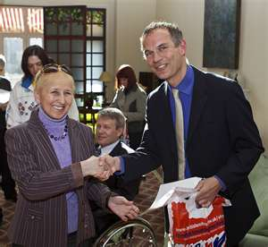
Fixes-Awarding Prize
Sends an email
Updates currentstatus with text
Currentstatus will end up stopping app from recalculating items again

Slide 21
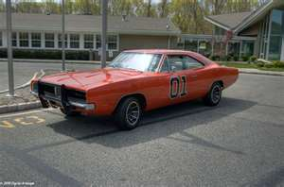
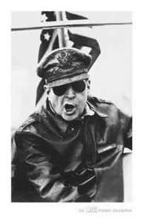
So what is the general case
Not sure yet
PersonPrize,Condition and Logic Statement For Sure
But could it be tweaked for better usability
The above assumes Characteristic and Person Characteristic
Environment might be too tied to program

Slide 22

So in summary
Prize engine structure
First use in testing
Found some issues with “abstraction” due to differences
Found solution with views, tt files, and SubSonic

